Slide 1
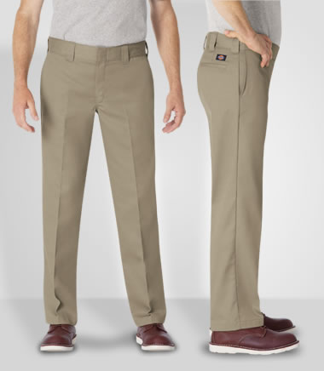
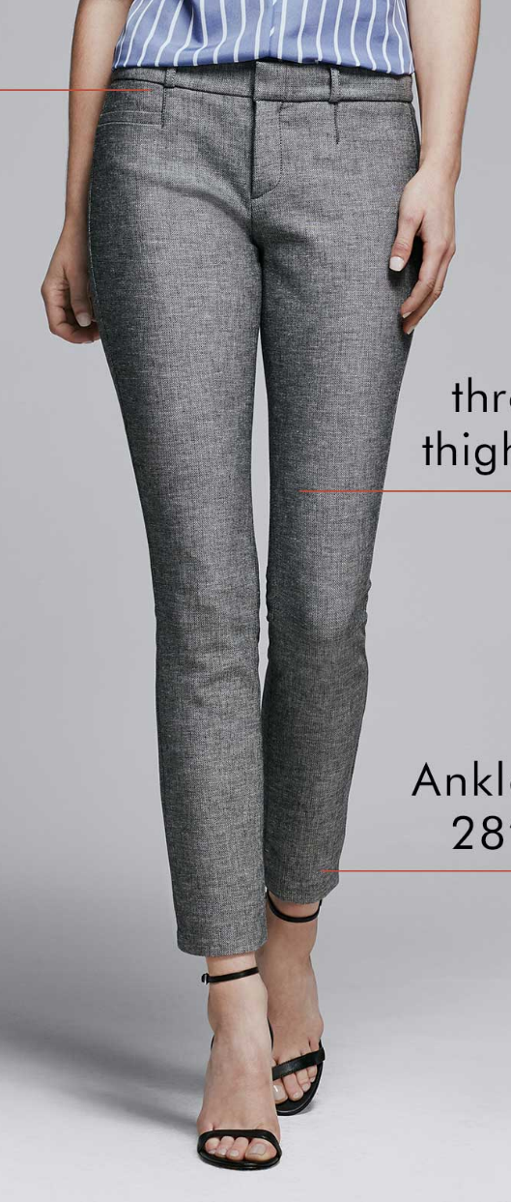
Body shape analysis to inform customized patternmaking
Pants

Slide 2
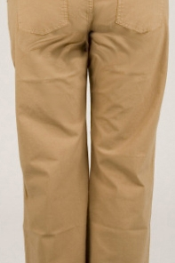
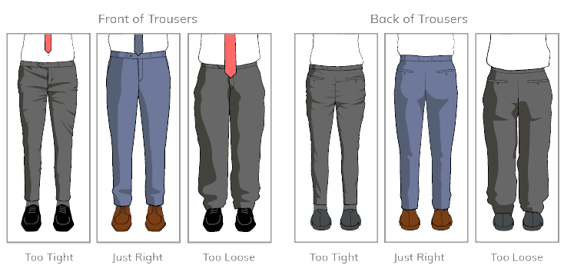
Pants are the most problematic garments to fit.

Slide 3
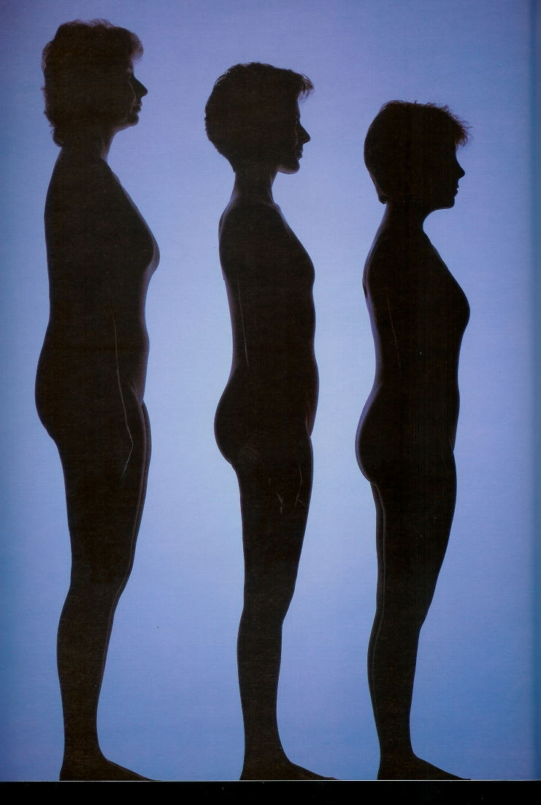
One pattern shape does not fit all
The current fashion system is broken- it assumes bodies are standard and makes people feel bad about themselves.

Slide 4
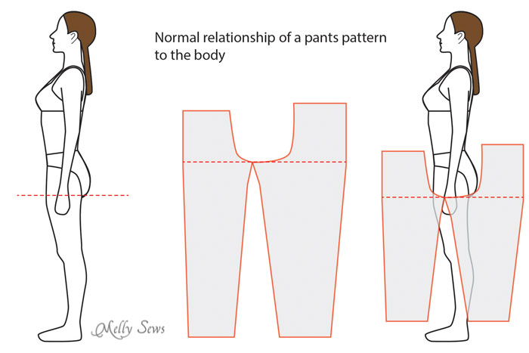
Pant Components

Slide 5
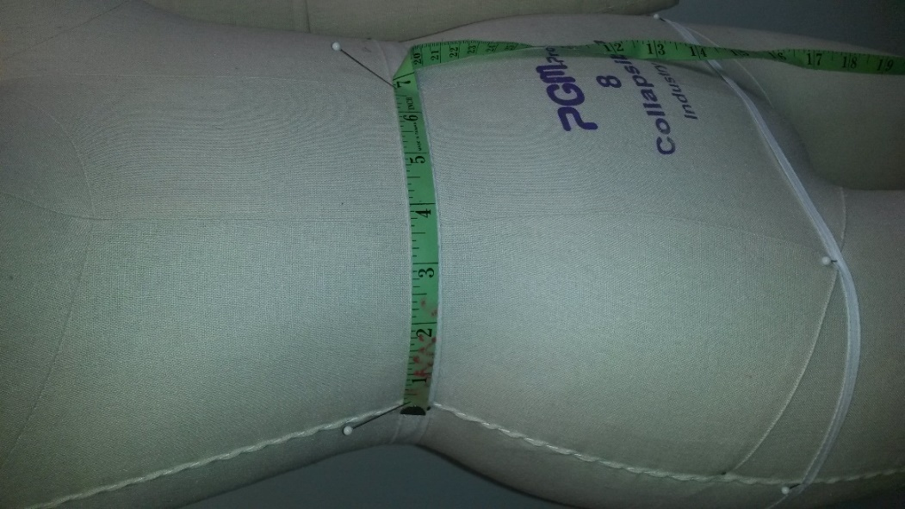
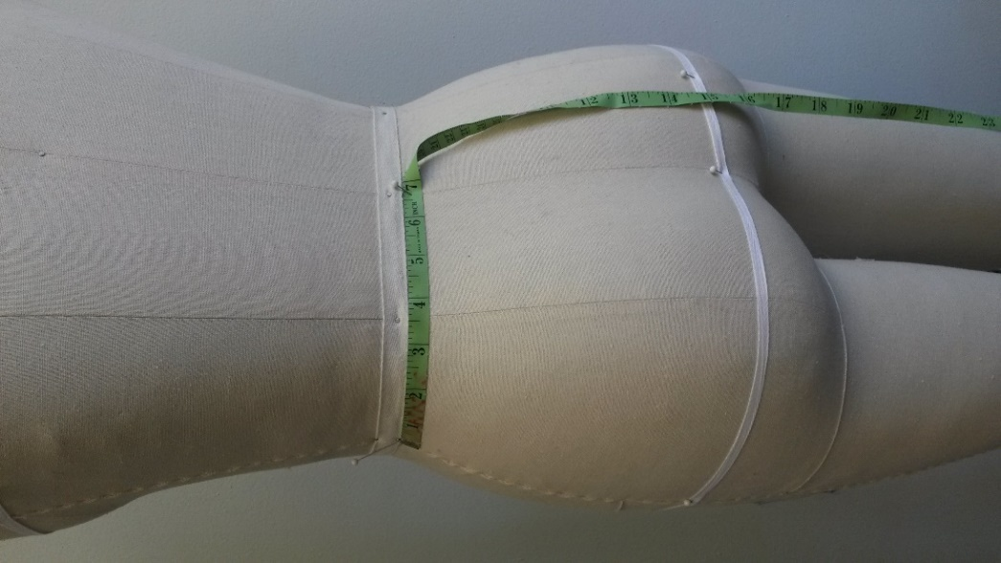
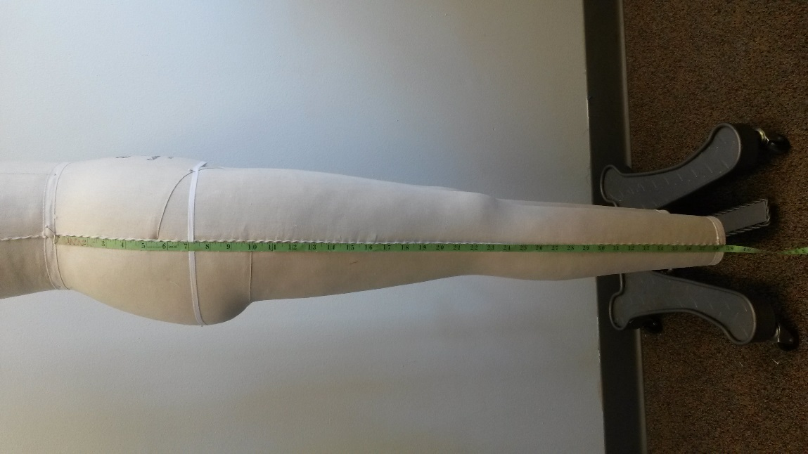
We take many measurements to draft pants patterns:
Vertical Length Measurements:
Waist to:
Ankle
Floor
Mid-knee
Crotch: Base of the torso where the legs join the body.
Crotch length
Crotch depth/ rise
Circumference Measurements: Waist arc, Hip arc, Upper thigh, Mid-thigh, Knee, Calf, Ankle, Foot entry

Slide 6
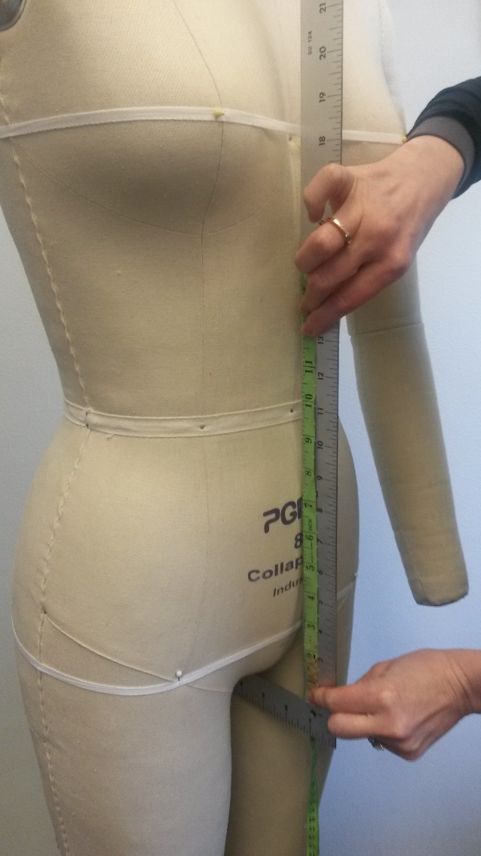
Crotch Depth/ rise
Form: With a square ruler in place, measure from waist level to crotch level (not to the end of the ruler).

Slide 7
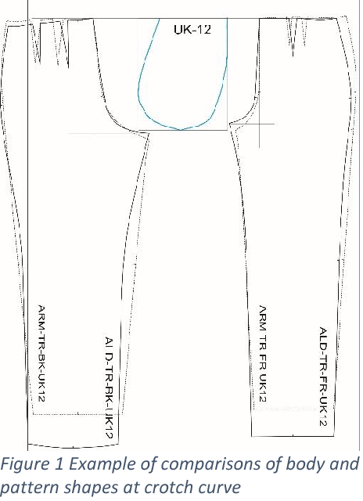
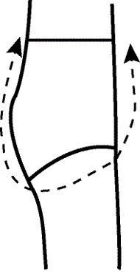
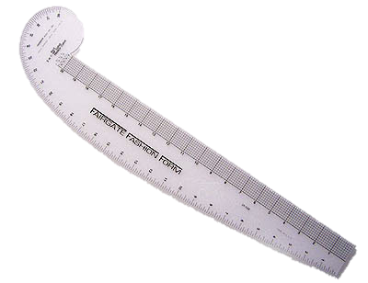
When drafting pants patterns, crotch curve is randomly drawn.
This is an important design variable that actually significantly affects how pants would fit.

Slide 8
“We have a lot of trouble with the rise shapes, especially with non flat/curvy body types.”

Slide 9
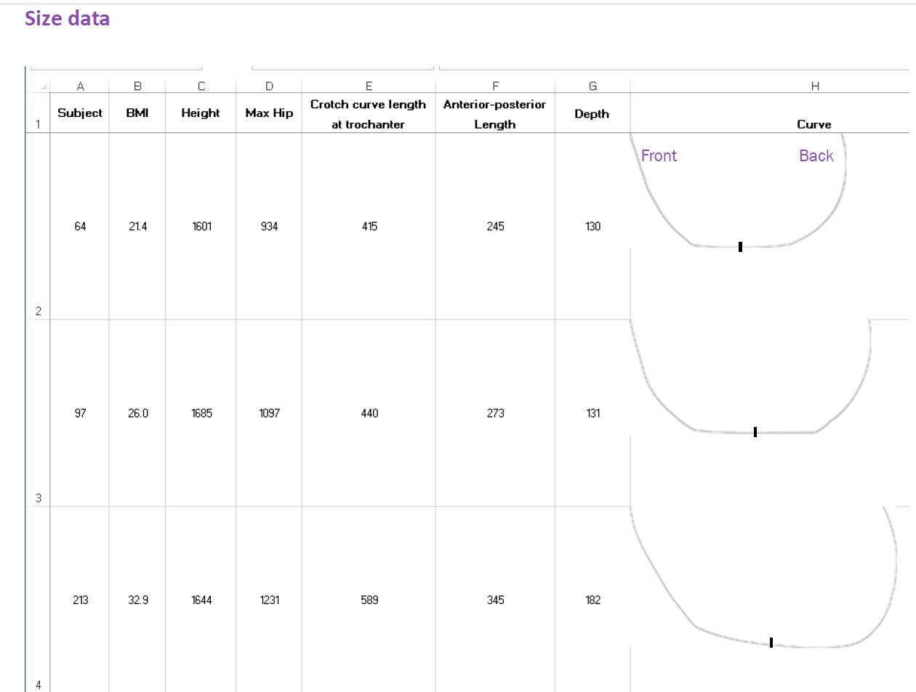
CAESAR 3D body scan database
(Civilian American and European Surface Anthropometry Resource)
Curves end at the trochanter level. They don’t go up to the waist level.

Slide 10
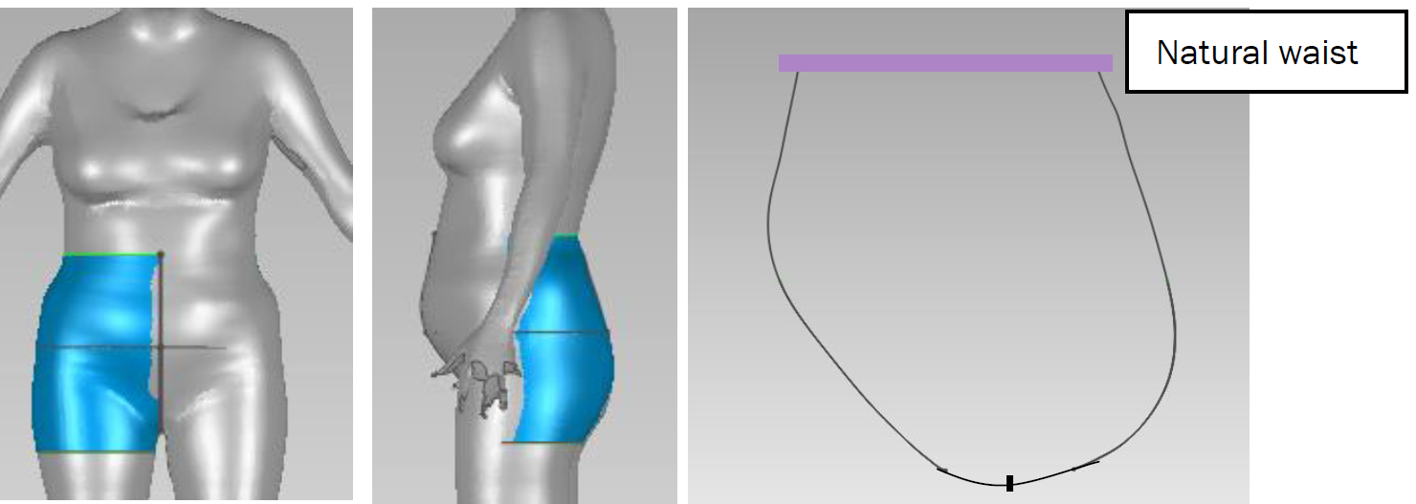
Trochanterion
landmark

Slide 11
Questions:
How can we extract features of the curves?
Are there any associations among height, weight, basic measurements (e.g., hip), and curve features that may help us group the curve shapes based on a few input and suggest using certain shapes when drafting patterns?

